Slide 1


Health Investigation and Air Sensing for Asian Pollution (Hi-ASAP)
SC Candice Lung, WC Vincent Wang
Research Center for Environmental Changes, Academia Sinica

Slide 2
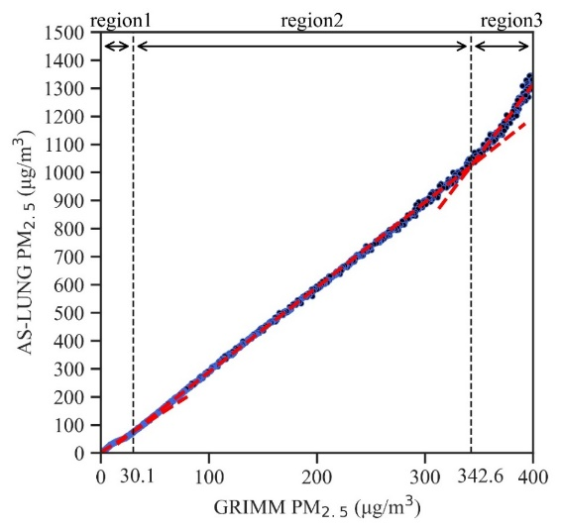
Proposed topic 1: Field and laboratory evaluations of low-cost sensors in the Asian cities with different emission sources (authors: WC Vincent Wang, SC Candice Lung‬, and other interested collaborators)
Background:
Environmental PM_{2.5} level is a common but serious issue in Asian cities. A suitable PM_{2.5} sensing device can help to monitor PM_{2.5} levels from various emission sources in the Asian cities.
Objective:
To evaluate the performance of AS-LUNG sets by conducting side-by-side comparison with research-grade instruments in laboratory, indoor, and ambient environments.
Note: You may start to conduct side-by-by comparison now; we only need 7 days of monitoring data for each city
Data collection:
All Hi-ASAP members are welcome to join this topic and upload your own PM_{2.5} comparison data.
These PM_{2.5} data should be monitored on non-rainy days.
Please email the data file to:
phdzen@gate.sinica.edu.tw
Fig. 1 Side-by-side PM_{2.5} comparison in the enclosed chamber (Wang et al., 2020, Sensor)
Table. 1 Comparison data upload format
 | Item |  | Item
1. | country | 10. | sensing device
2. | region/area | 11. | sensing device_sensor
3. | longitude | 12. | sensing device_sensorPM₁
4. | latitude | 13. | sensing device_sensorPM_{2.5}
5. | comparison environment | 14. | reference instrument
6. | comparison environment description | 15. | reference instrument_PM₁
7. | main emission sources | 16. | reference instrument_PM_{2.5}
8. | UTC (coordinated universal time) | 17. | temperature
9. | season | 18. | relative humidity

Slide 3
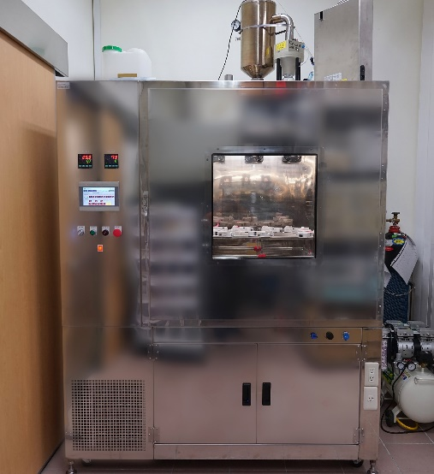
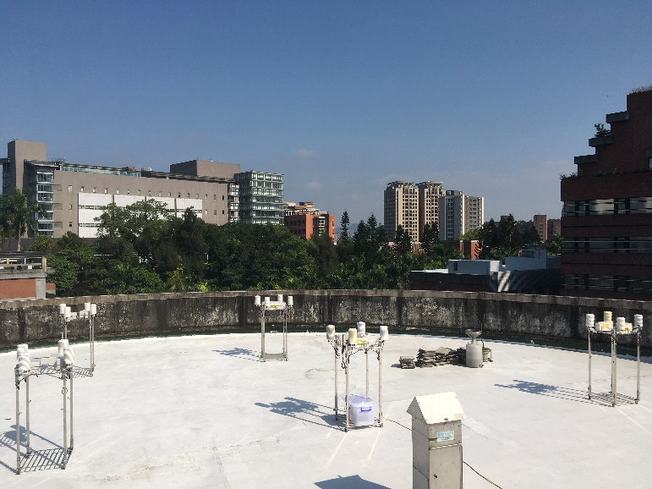
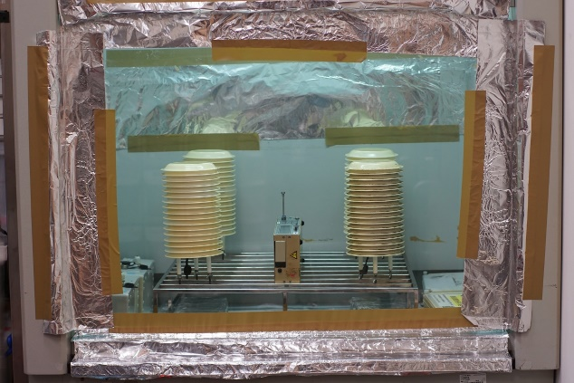
Environment of side-by-side comparison
Indoor
Outdoor
Hood
Chamber
Roof

Slide 4
Data collection
Country | City | Environment | Emission | Data intervals(min) | Reference instrument
Taiwan | Taipei | outdoor | ambient | 1 | GRIMM
Taiwan | Taipei | chamber | incense | 1 | GRIMM
Bangladesh | Dhaka | indoor | ambient | 15 | BlueSky Air Quality Monitor
Vietnam | Ho Chi Minh | chamber | incense | 1 | DustTrak
Myanmar | Mandalay | outdoor | waste burning | 1 | EPAS

Slide 5
Thank you for your attention!

